Slide 1
z/OS DevOps End-to-End Overview
Nelson Lopez
Z DevOps Transformation Specialist
Nelson.lopez59@hotmail.com

Slide 2
Session Objectives
Concepts
DevOps on Z
Continuous Integration / Continuous Deployment (CI/CD)
Git for Z
IBM’s Dependency Based Build Tool (DBB)
Urban Code Deploy for Z
Demo A Basic End-to-End workflow
Getting Started

Slide 3
Z DevOps
A modern Z DevOps workflow is founded on sound Agile practices and leverages tools and skills to streamline all phases of the process.
It fosters a culture of cooperation and efficiency across all levels of support – Business Partners, Developers, QA, Release Engineers and Operations.

Slide 4
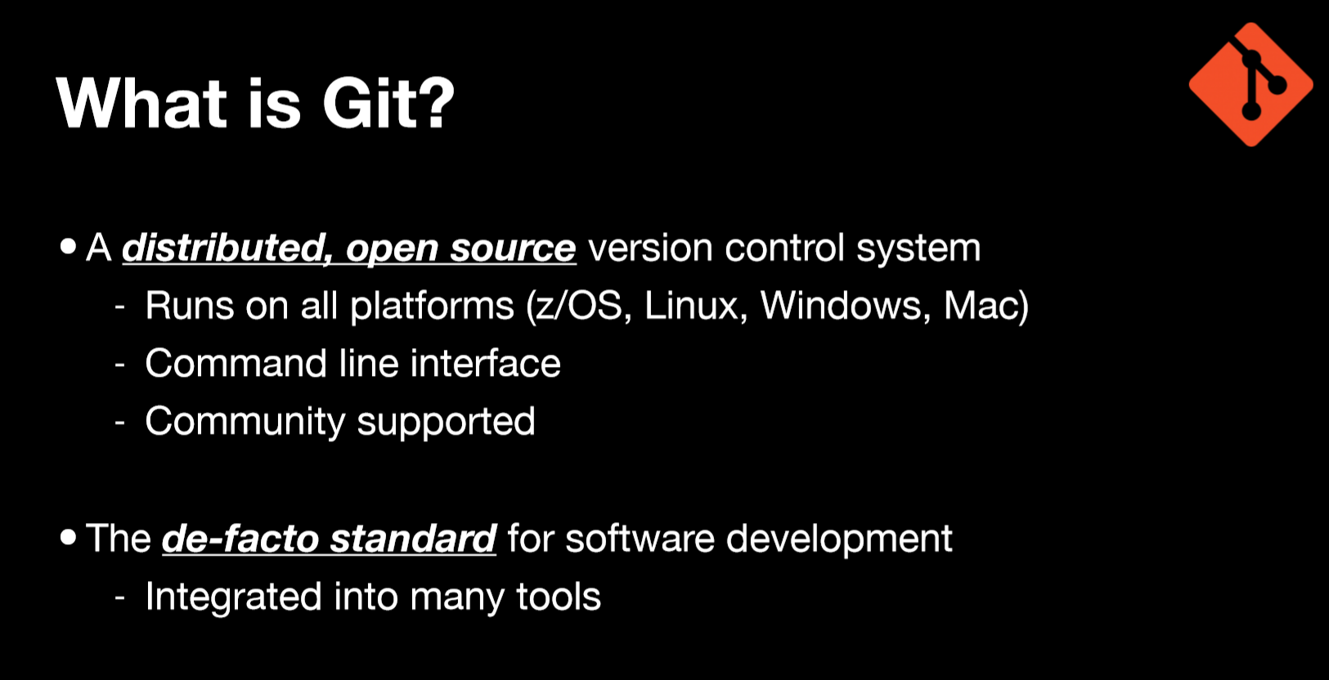


Slide 5
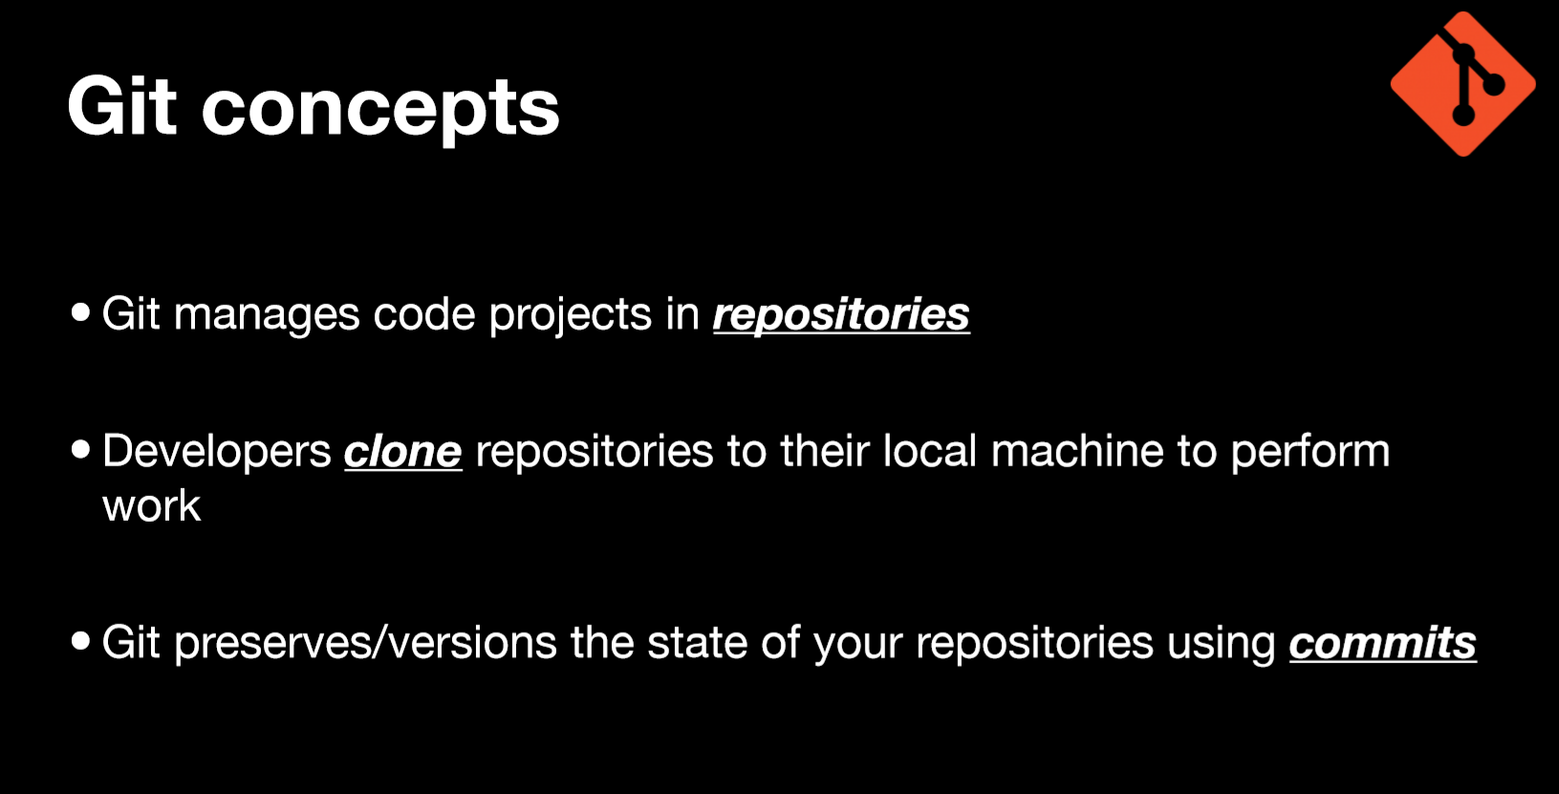
Git manages code projects in repositories
Developers clone repo(s) to their local PC to work
Git preserves/versions the state of a repo using commits
A branch allows developers to work in isolation

Slide 6
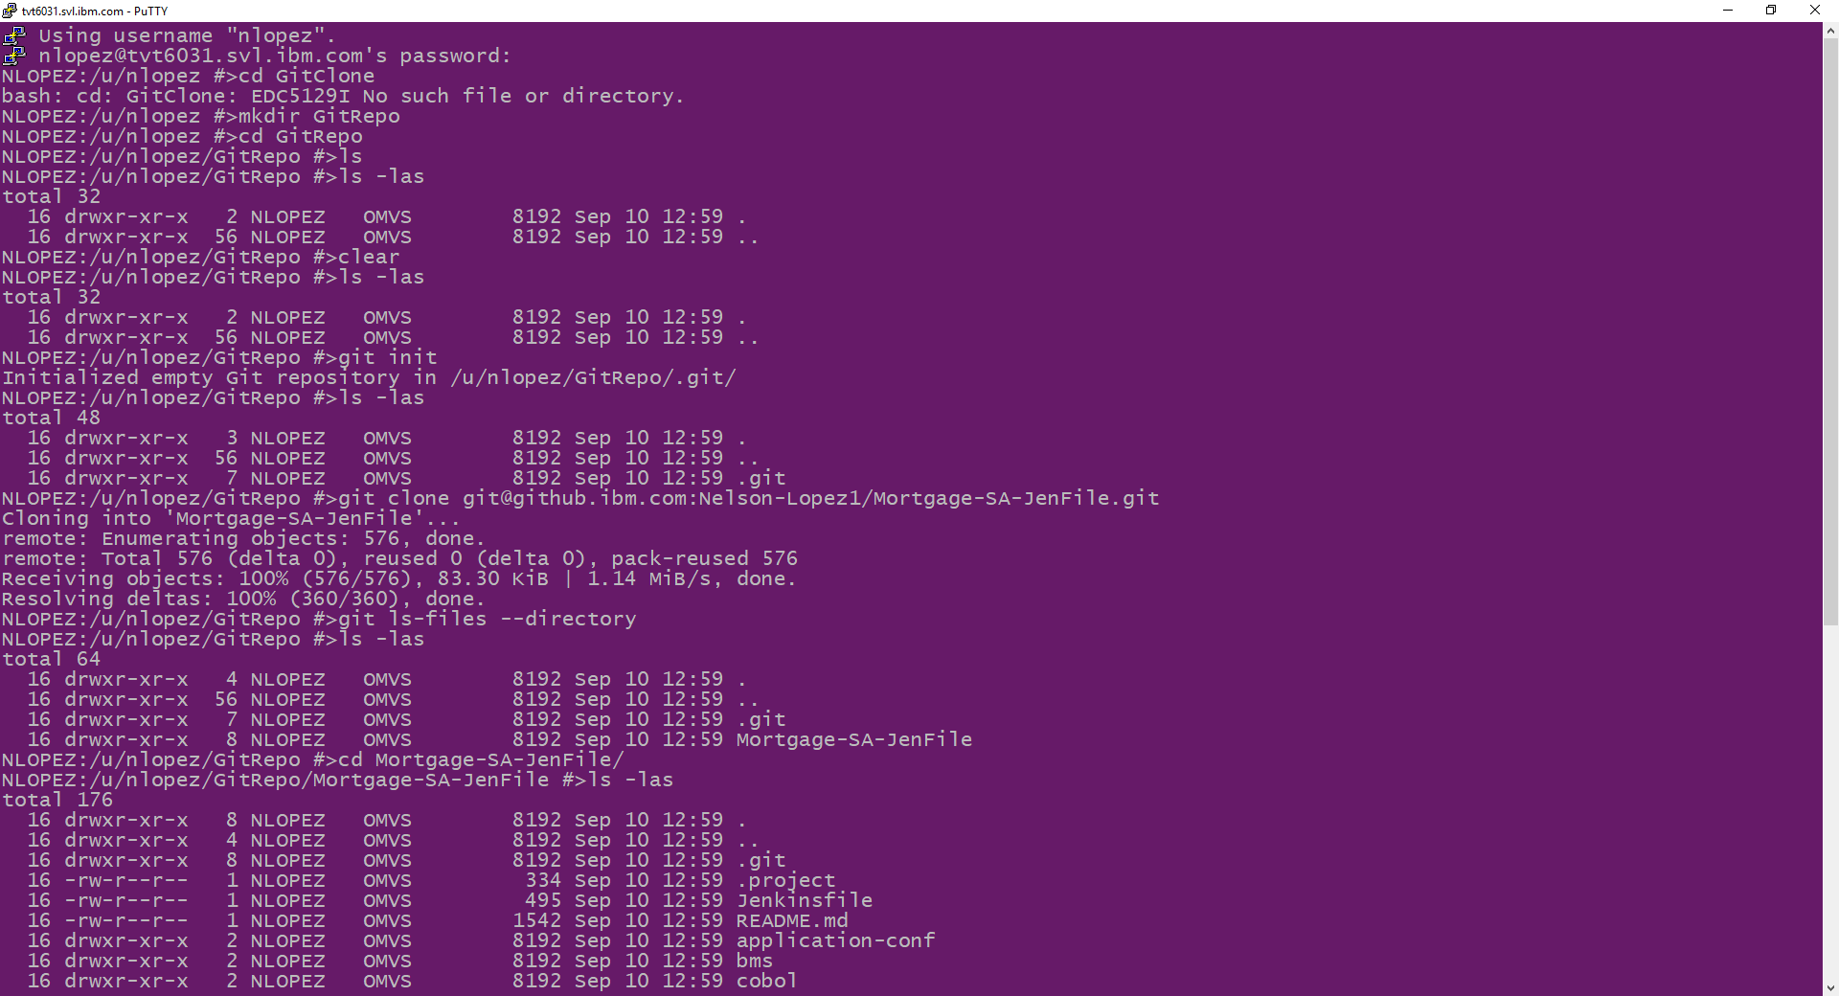
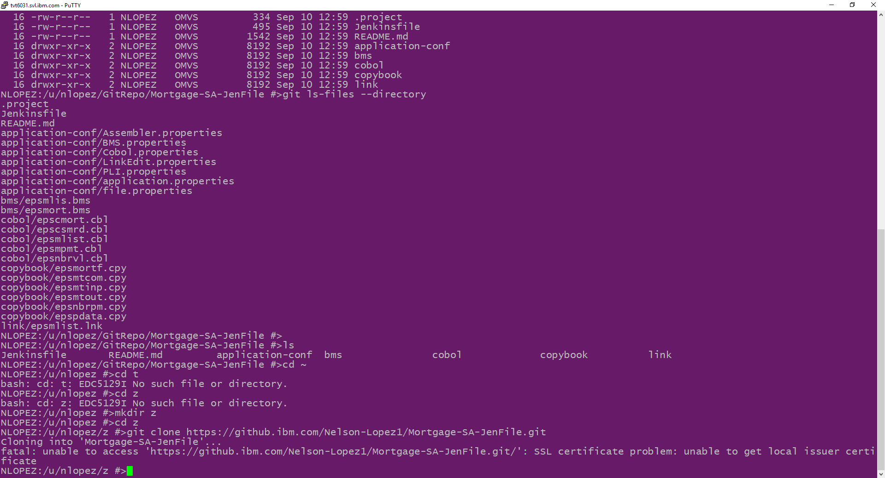
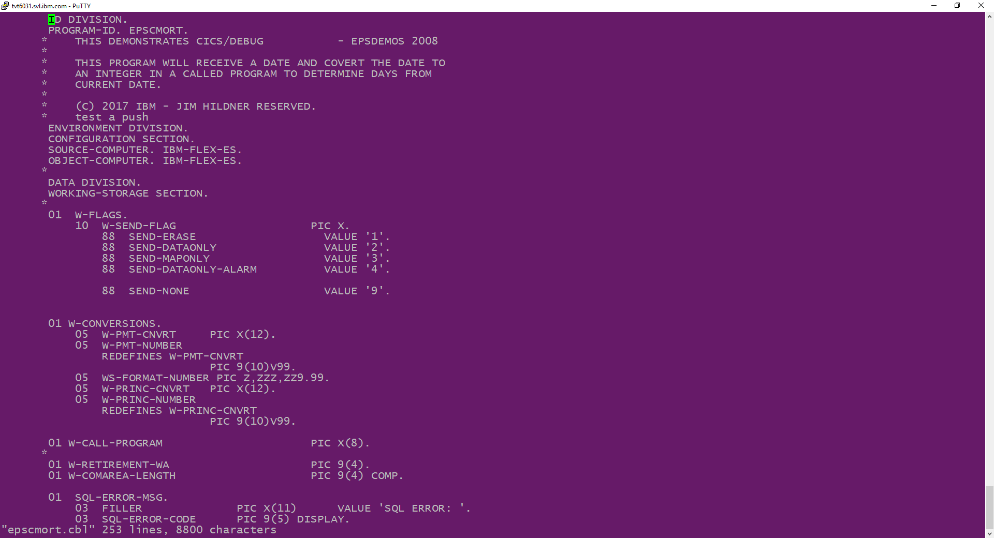
Clone a COBOL repo on Z
git clone your-repo=url

Slide 7
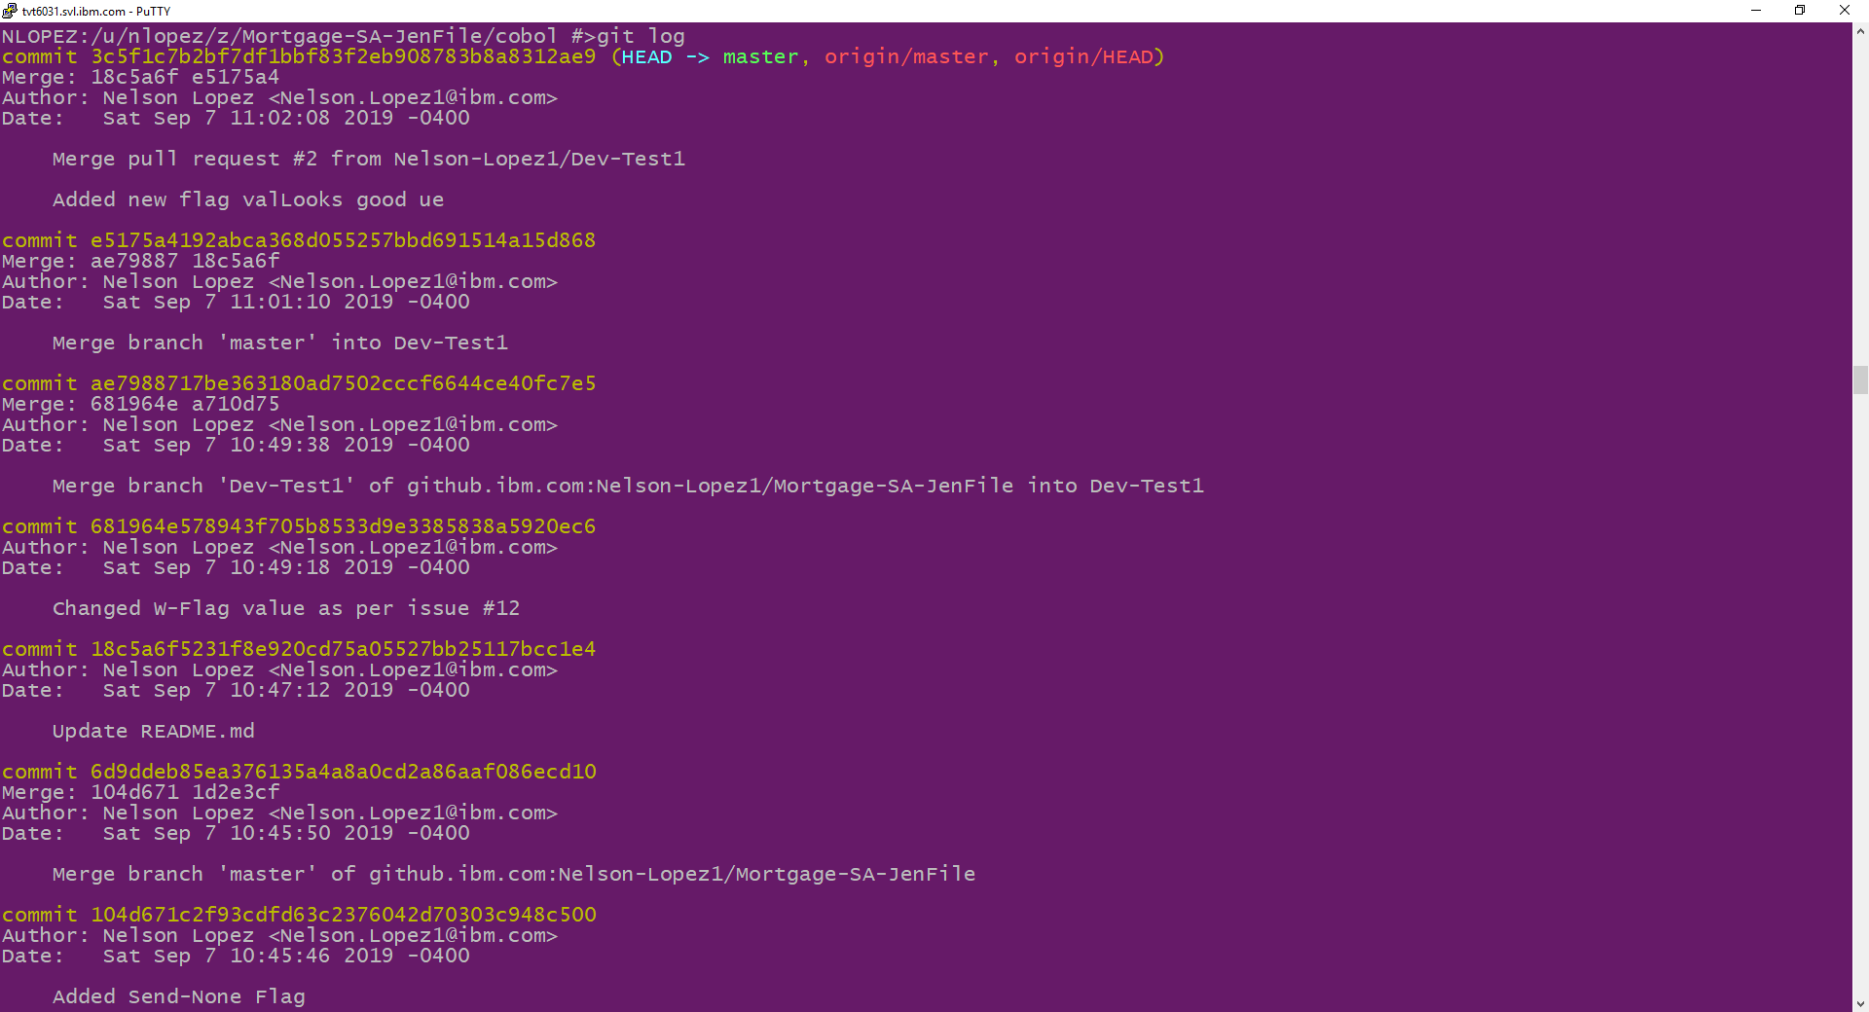
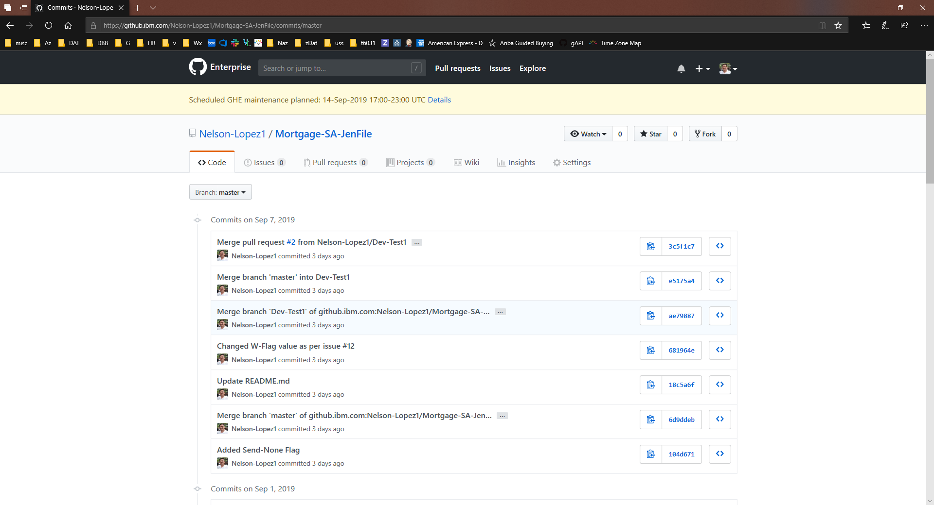
View the commit log
git log

Slide 8
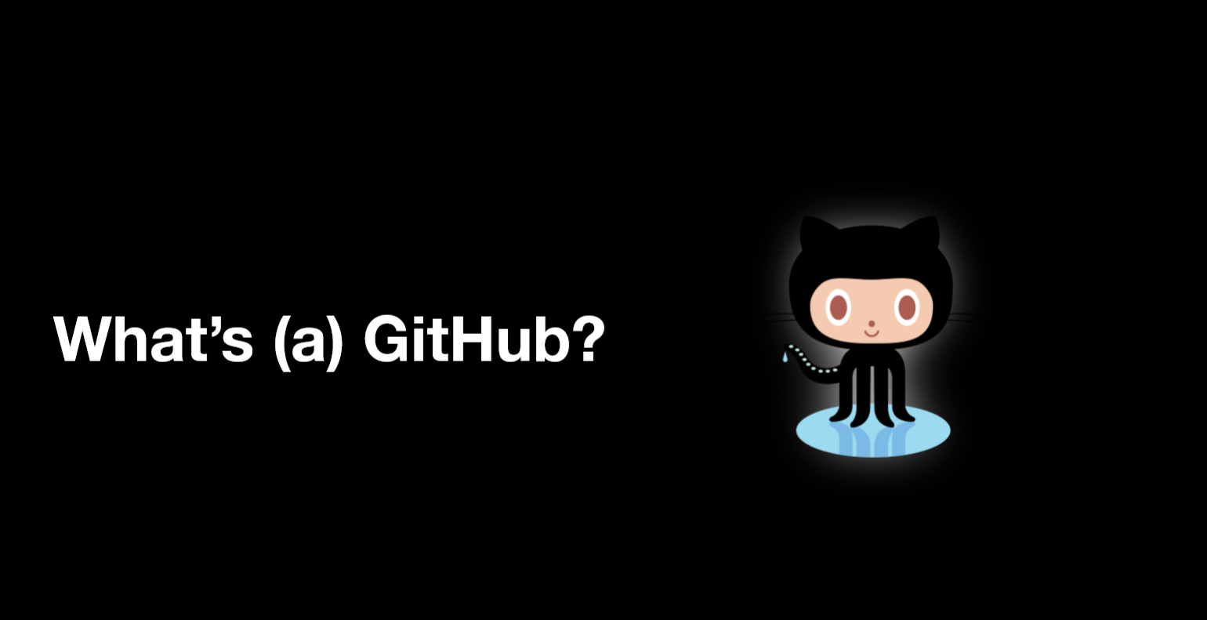

Slide 9
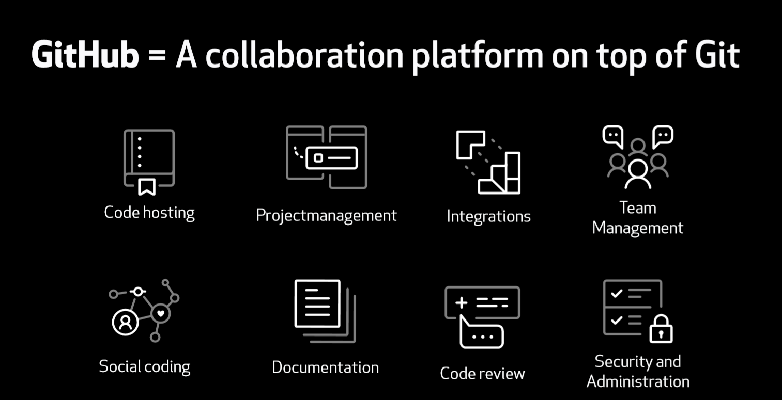

Slide 10
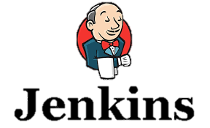



DBB Architecture (Continuous Integration Phase)
Start Job
Status, logs and links to reports
z/OS
PR
Agent
MVS Java API’s
PDS
Any Git Server
CLONE
Main Repository
CLONE to Z
Groovy Build scripts
Compile
&
link
Run Groovy build script
Return status and Logs
Scan, impact analysis, copy to PDS, compile, create artifacts, & report
Desktop IDE
USS
MVS

Slide 11
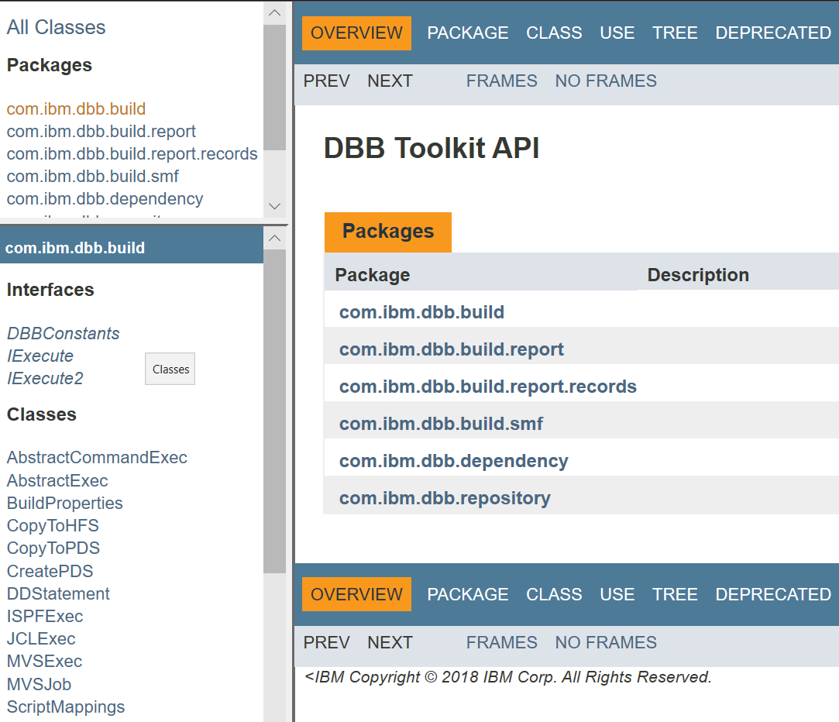
DBB Java API Toolkit
A set of Java APIs used to define scripts that:
Run MVS programs, TSO/ISPF commands, Submit JCL
Scan, store and retrieve application dependency metadata
Utilities to copy to/from PDS’s and USS zFS
Migrate source from PDS’s to Git

Slide 12
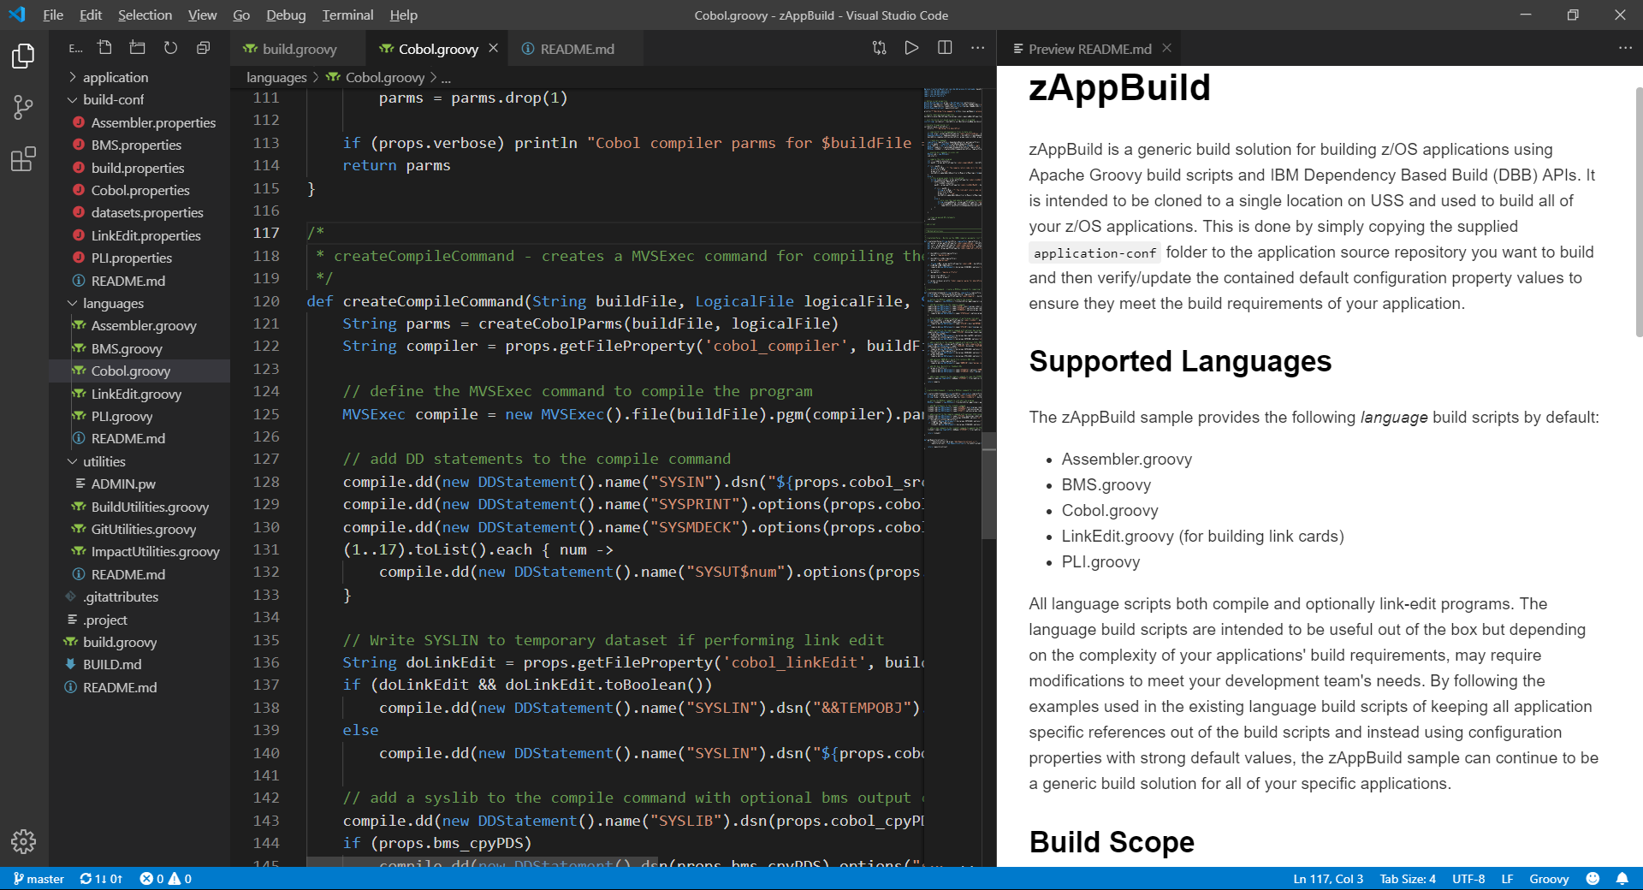
JCL vs Groovy+DBB APIs
import com.ibm.dbb.build.*
println("Copying source from zFS to PDS . . .")
def copy = new CopyToPDS().file(new File("/u/usr1/build/helloworld.cbl"))
.dataset("USR1.BUILD.COBOL").member("HELLO")
copy.execute()
println("Compiling . . .")
def tempOps = “tracks space(5,5) unit(vio) blksize(80) lrecl(80) recfm(f,b) new"
def compile = new MVSExec().pgm("IGYCRCTL").parm("LIB")
compile.dd(new DDStatement().name("TASKLIB").dsn("IGY.SIGYCOMP").options("shr"))
compile.dd(new DDStatement().name("SYSIN").dsn("USR1.BUILD.COBOL(HELLO)")
.options("shr"))
compile.dd(new DDStatement().name("SYSLIN").dsn("USR1.BUILD.OBJ(HELLO)")
.options("shr"))
compile.dd(new DDStatement().name("SYSPRINT").options(tempOps))
compile.dd(new DDStatement().name("SYSUT1").options(tempOps))
compile.dd(new DDStatement().name("SYSUT2").options(tempOps))
compile.dd(new DDStatement().name("SYSUT3").options(tempOps))
compile.dd(new DDStatement().name("SYSUT4").options(tempOps))
compile.dd(new DDStatement().name("SYSUT5").options(tempOps))
compile.dd(new DDStatement().name("SYSUT6").options(tempOps))
compile.dd(new DDStatement().name("SYSUT7").options(tempOps))
compile.copy(new CopyToHFS().ddName("SYSPRINT")
.file(new File("/u/usr1/build/helloworld.log")))
def rc = compile.execute()
if (rc > 4)
println("Compile failed! RC=$rc")
else
println("Compile successful! RC=$rc")
//COBOL EXEC PGM=IGYCRCTL,REGION=0M,
// PARM='LIB'
//*
//STEPLIB DD DISP=SHR,DSN=IGY.SIGYCOMP
//*
//SYSIN DD DISP=SHR,DSN=USER1.BUILD.COBOL(HELLO)
//SYSLIN DD DISP=SHR,DSN=USER1.BUILD.OBJ(HELLO)
//SYSPRINT DD SYSOUT=*
//SYSUT1 DD DISP=(NEW,PASS),SPACE=(TRK,(5,5)),UNIT=VIO,
// BLKSIZE=80,LRECL=80,RECFM=FB
//SYSUT2 DD DISP=(NEW,PASS),SPACE=(TRK,(5,5)),UNIT=VIO,
// BLKSIZE=80,LRECL=80,RECFM=FB
//SYSUT3 DD DISP=(NEW,PASS),SPACE=(TRK,(5,5)),UNIT=VIO,
// BLKSIZE=80,LRECL=80,RECFM=FB
//SYSUT4 DD DISP=(NEW,PASS),SPACE=(TRK,(5,5)),UNIT=VIO,
// BLKSIZE=80,LRECL=80,RECFM=FB
//SYSUT5 DD DISP=(NEW,PASS),SPACE=(TRK,(5,5)),UNIT=VIO,
// BLKSIZE=80,LRECL=80,RECFM=FB
//SYSUT6 DD DISP=(NEW,PASS),SPACE=(TRK,(5,5)),UNIT=VIO,
// BLKSIZE=80,LRECL=80,RECFM=FB
//SYSUT7 DD DISP=(NEW,PASS),SPACE=(TRK,(5,5)),UNIT=VIO,
// BLKSIZE=80,LRECL=80,RECFM=FB

Slide 13
DBB Build Modes
Single Program - Build a single program in the application.
List of Programs - Build a list of programs provided by a text file.
Full Build - Build all programs (or buildable files) of an application.
Impact Build - Build only programs impacted changed since the last build.
Branch Build - Detects when building a topic branch for the first time and will automatically clone the dependency data collections from the main build branch in order to avoid having to rescan the entire application.
Scan Only - Skip the actual building and only scan source files for dependency data
¹

Slide 14
DBB Web Application
application dependency information
build reports
REST APIs access
DBB Sample Build Framework
free groovy scripts to build your own CI process
Visit and contribute to our public DBB repo
https://github.com/IBM/dbb

Slide 15
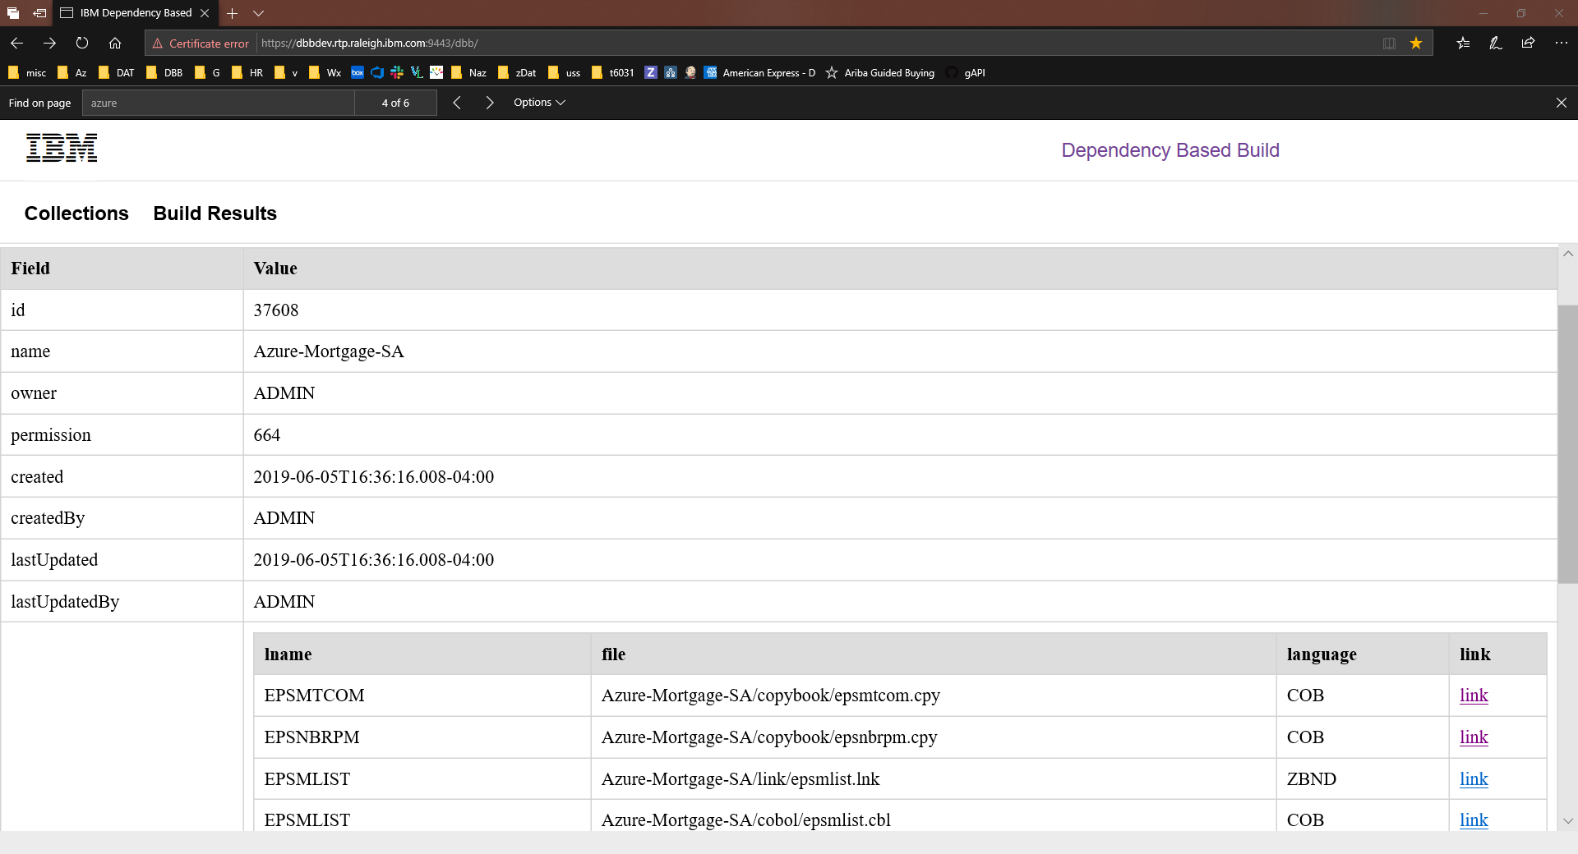

Slide 16
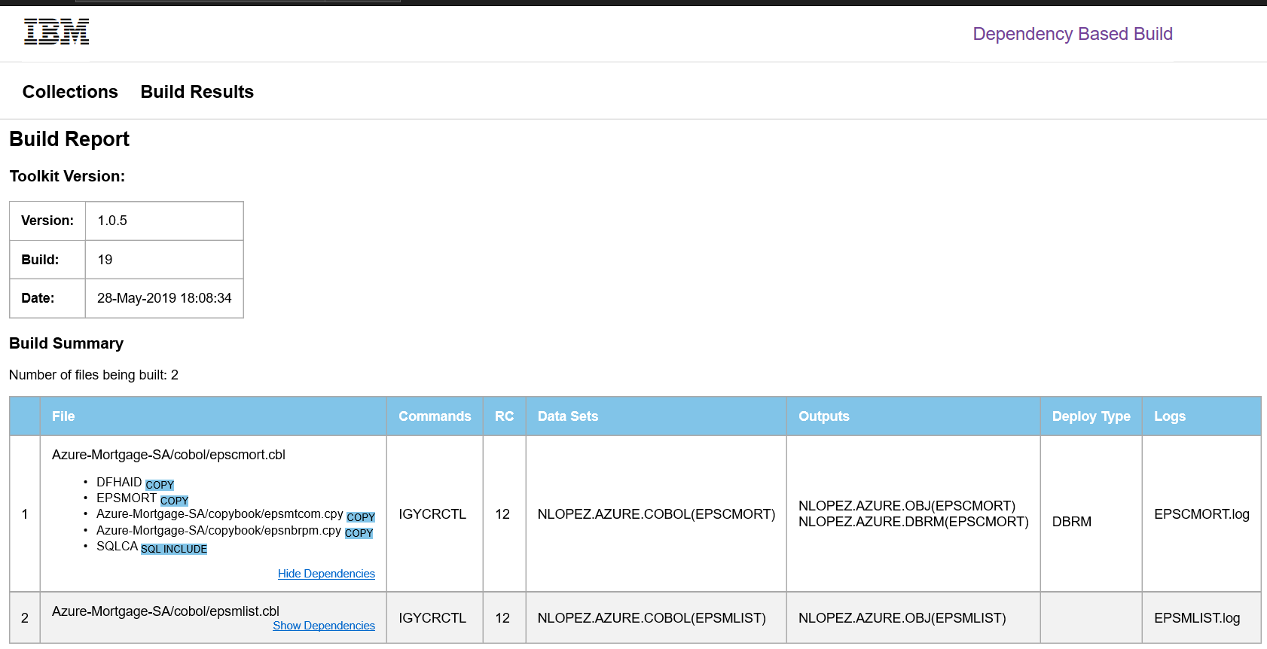

Slide 17
What is Groovy?

Slide 18
Groovy is a modern versatile scripting language widely used for DevOps automation
It integrates with Java programs or Toolkits like DBB
Concise, readable and expressive syntax and easy to learn
Jenkins uses Groovy for its native scripting support
DBB comes with a sample groovy framework called zAppBuild

Slide 19
JCL vs Groovy+DBB APIs
import com.ibm.dbb.build.*
println("Copying source from zFS to PDS . . .")
def copy = new CopyToPDS().file(new File("/u/usr1/build/helloworld.cbl"))
.dataset("USR1.BUILD.COBOL").member("HELLO")
copy.execute()
println("Compiling . . .")
def tempOps = “tracks space(5,5) unit(vio) blksize(80) lrecl(80) recfm(f,b) new"
def compile = new MVSExec().pgm("IGYCRCTL").parm("LIB")
compile.dd(new DDStatement().name("TASKLIB").dsn("IGY.SIGYCOMP").options("shr"))
compile.dd(new DDStatement().name("SYSIN").dsn("USR1.BUILD.COBOL(HELLO)")
.options("shr"))
compile.dd(new DDStatement().name("SYSLIN").dsn("USR1.BUILD.OBJ(HELLO)")
.options("shr"))
compile.dd(new DDStatement().name("SYSPRINT").options(tempOps))
compile.dd(new DDStatement().name("SYSUT1").options(tempOps))
compile.dd(new DDStatement().name("SYSUT2").options(tempOps))
compile.dd(new DDStatement().name("SYSUT3").options(tempOps))
compile.dd(new DDStatement().name("SYSUT4").options(tempOps))
compile.dd(new DDStatement().name("SYSUT5").options(tempOps))
compile.dd(new DDStatement().name("SYSUT6").options(tempOps))
compile.dd(new DDStatement().name("SYSUT7").options(tempOps))
compile.copy(new CopyToHFS().ddName("SYSPRINT")
.file(new File("/u/usr1/build/helloworld.log")))
def rc = compile.execute()
if (rc > 4)
println("Compile failed! RC=$rc")
else
println("Compile successful! RC=$rc")
//COBOL EXEC PGM=IGYCRCTL,REGION=0M,
// PARM='LIB'
//*
//STEPLIB DD DISP=SHR,DSN=IGY.SIGYCOMP
//*
//SYSIN DD DISP=SHR,DSN=USER1.BUILD.COBOL(HELLO)
//SYSLIN DD DISP=SHR,DSN=USER1.BUILD.OBJ(HELLO)
//SYSPRINT DD SYSOUT=*
//SYSUT1 DD DISP=(NEW,PASS),SPACE=(TRK,(5,5)),UNIT=VIO,
// BLKSIZE=80,LRECL=80,RECFM=FB
//SYSUT2 DD DISP=(NEW,PASS),SPACE=(TRK,(5,5)),UNIT=VIO,
// BLKSIZE=80,LRECL=80,RECFM=FB
//SYSUT3 DD DISP=(NEW,PASS),SPACE=(TRK,(5,5)),UNIT=VIO,
// BLKSIZE=80,LRECL=80,RECFM=FB
//SYSUT4 DD DISP=(NEW,PASS),SPACE=(TRK,(5,5)),UNIT=VIO,
// BLKSIZE=80,LRECL=80,RECFM=FB
//SYSUT5 DD DISP=(NEW,PASS),SPACE=(TRK,(5,5)),UNIT=VIO,
// BLKSIZE=80,LRECL=80,RECFM=FB
//SYSUT6 DD DISP=(NEW,PASS),SPACE=(TRK,(5,5)),UNIT=VIO,
// BLKSIZE=80,LRECL=80,RECFM=FB
//SYSUT7 DD DISP=(NEW,PASS),SPACE=(TRK,(5,5)),UNIT=VIO,
// BLKSIZE=80,LRECL=80,RECFM=FB

Slide 20
Your Cobol code on Git & DBB

Slide 21
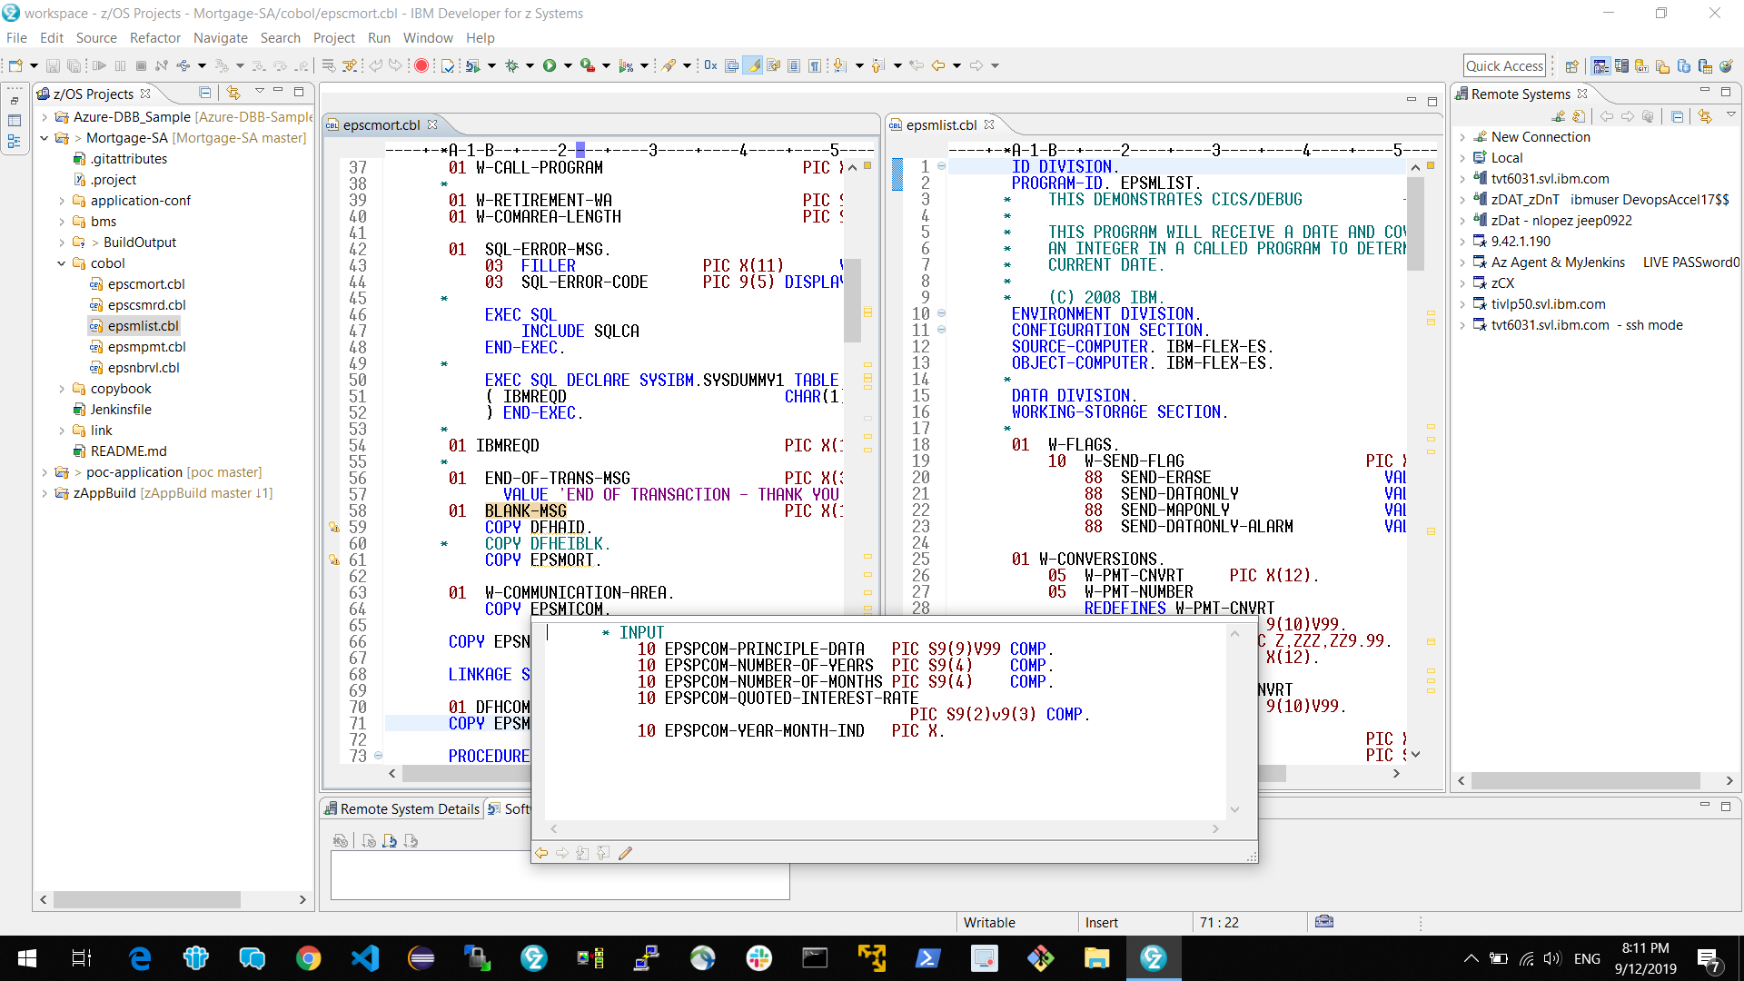
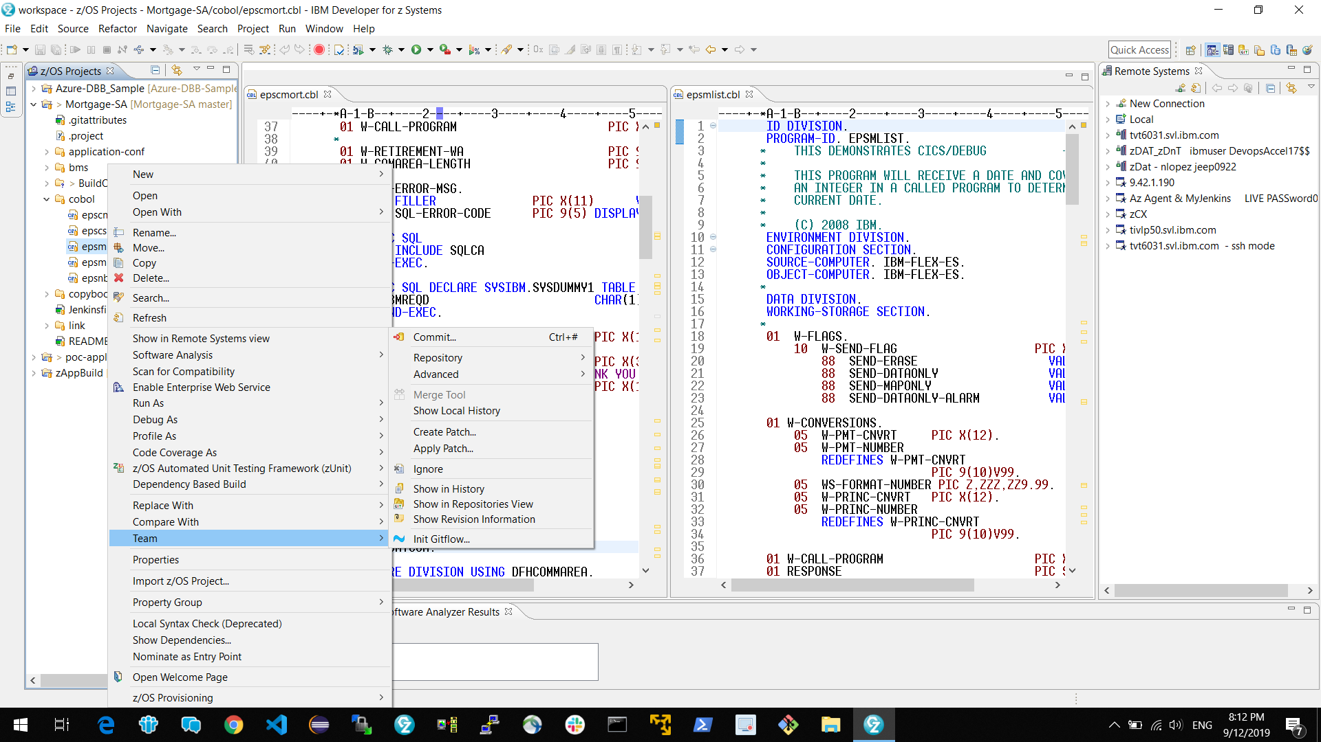
Developer Phase – IDz & eGit
A developer's flow:
clone
branch
update code
unit test
commit

Slide 22
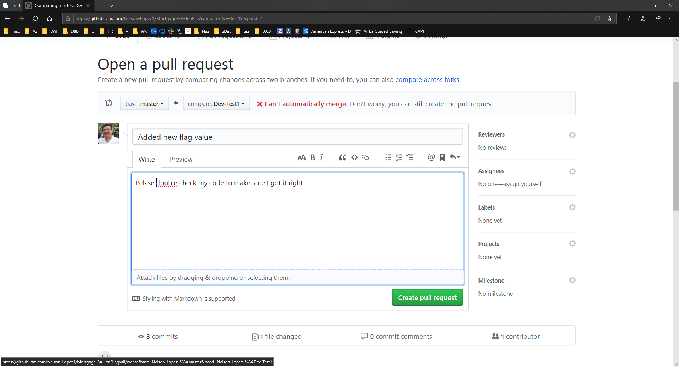
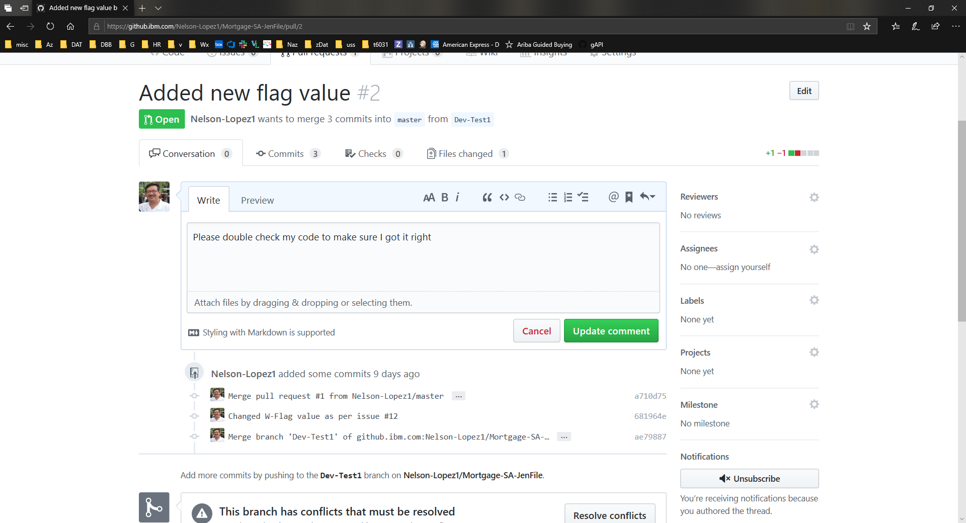
Continuous Integration Phase – Pull Requests and Jenkins
Developer:
Document the change
Pull Request (PR)
Triggers a Pipeline Feature Build

Slide 23
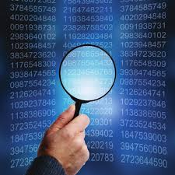
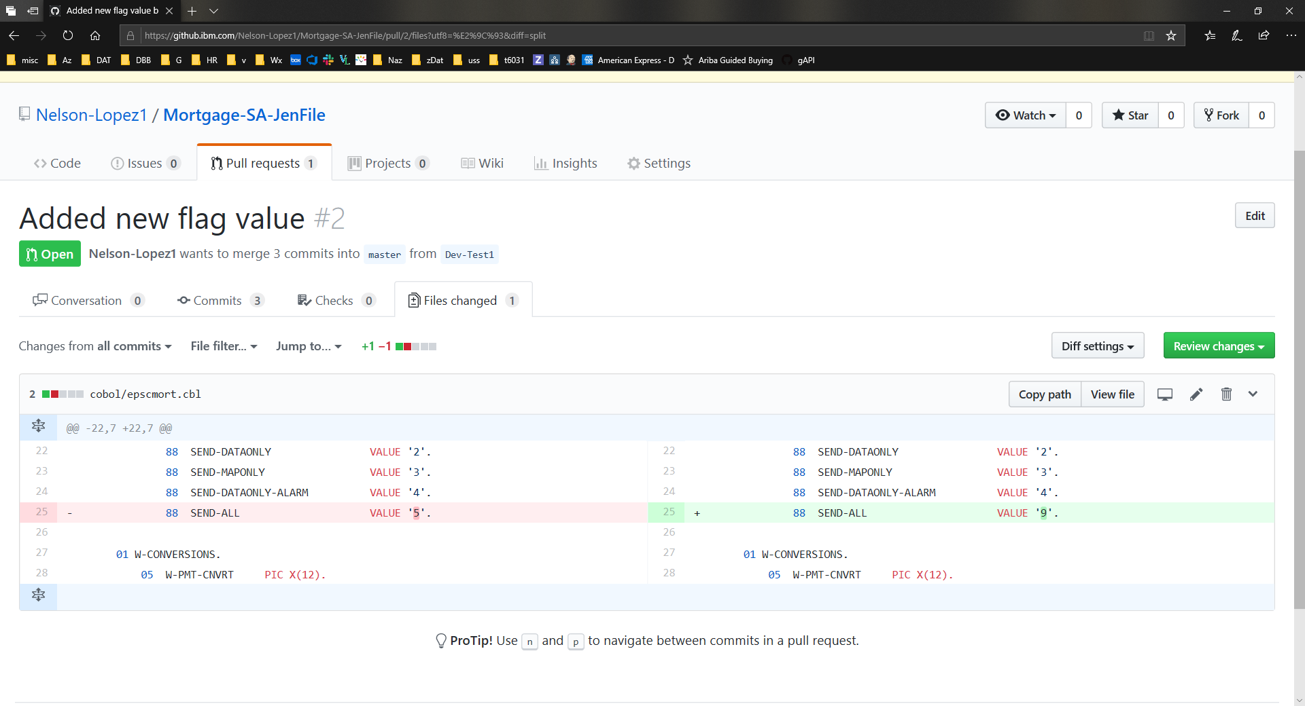
Peer Code Review
Diff old vs new

Slide 24
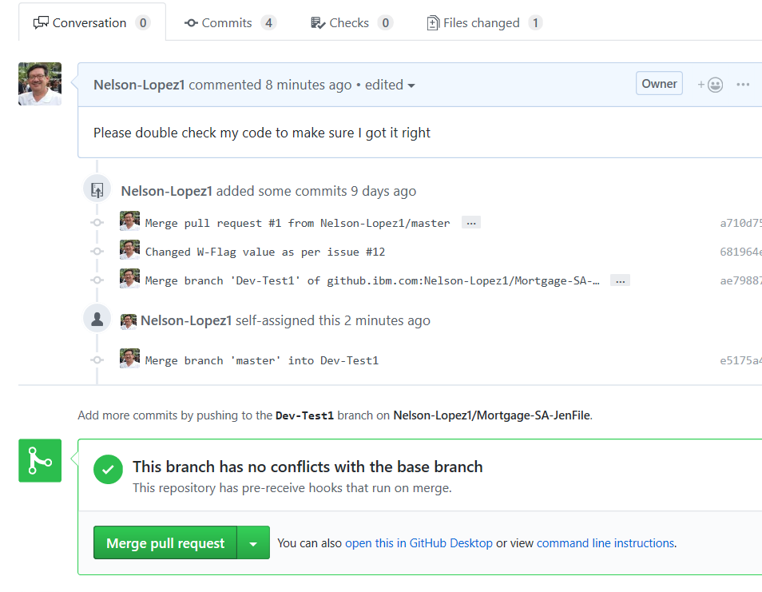
Team Lead:
- Merge the PR
- Triggers Team Build

Slide 25
Deployment

Slide 26
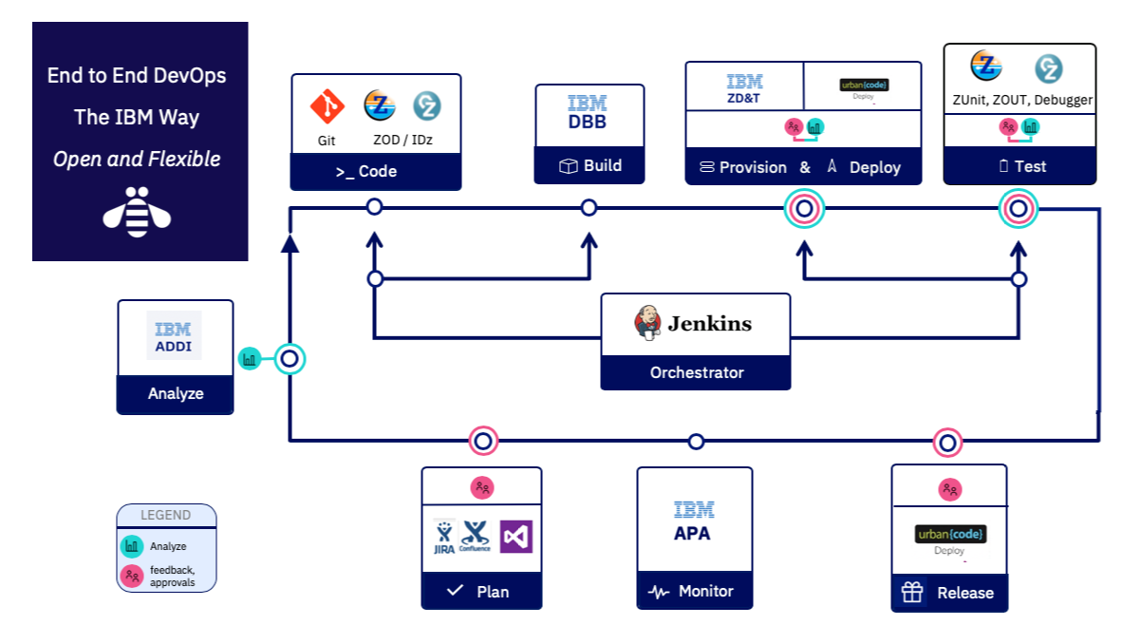
CD Phase
Notes:
What we want to do is provide this pipeline as the automation framework for the DevOps transformation

Slide 27
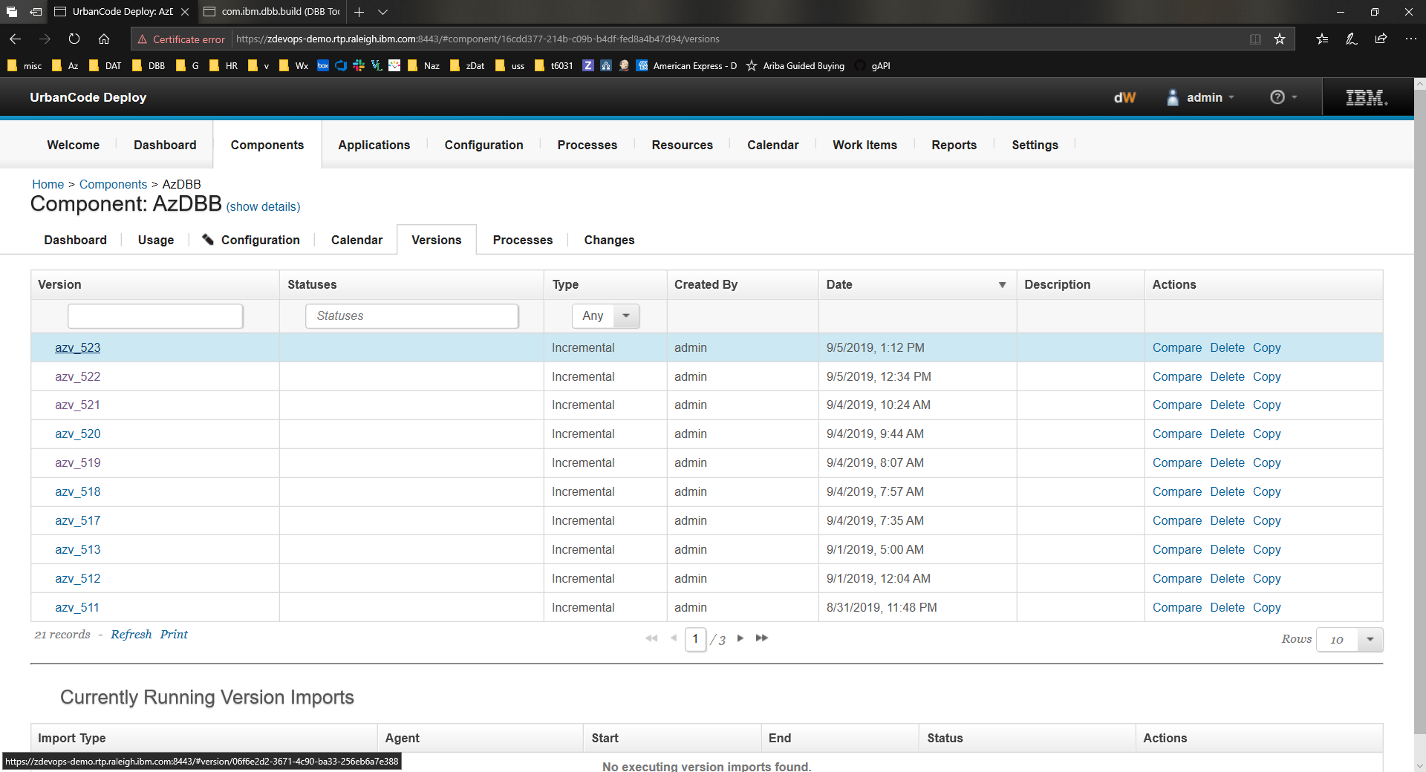
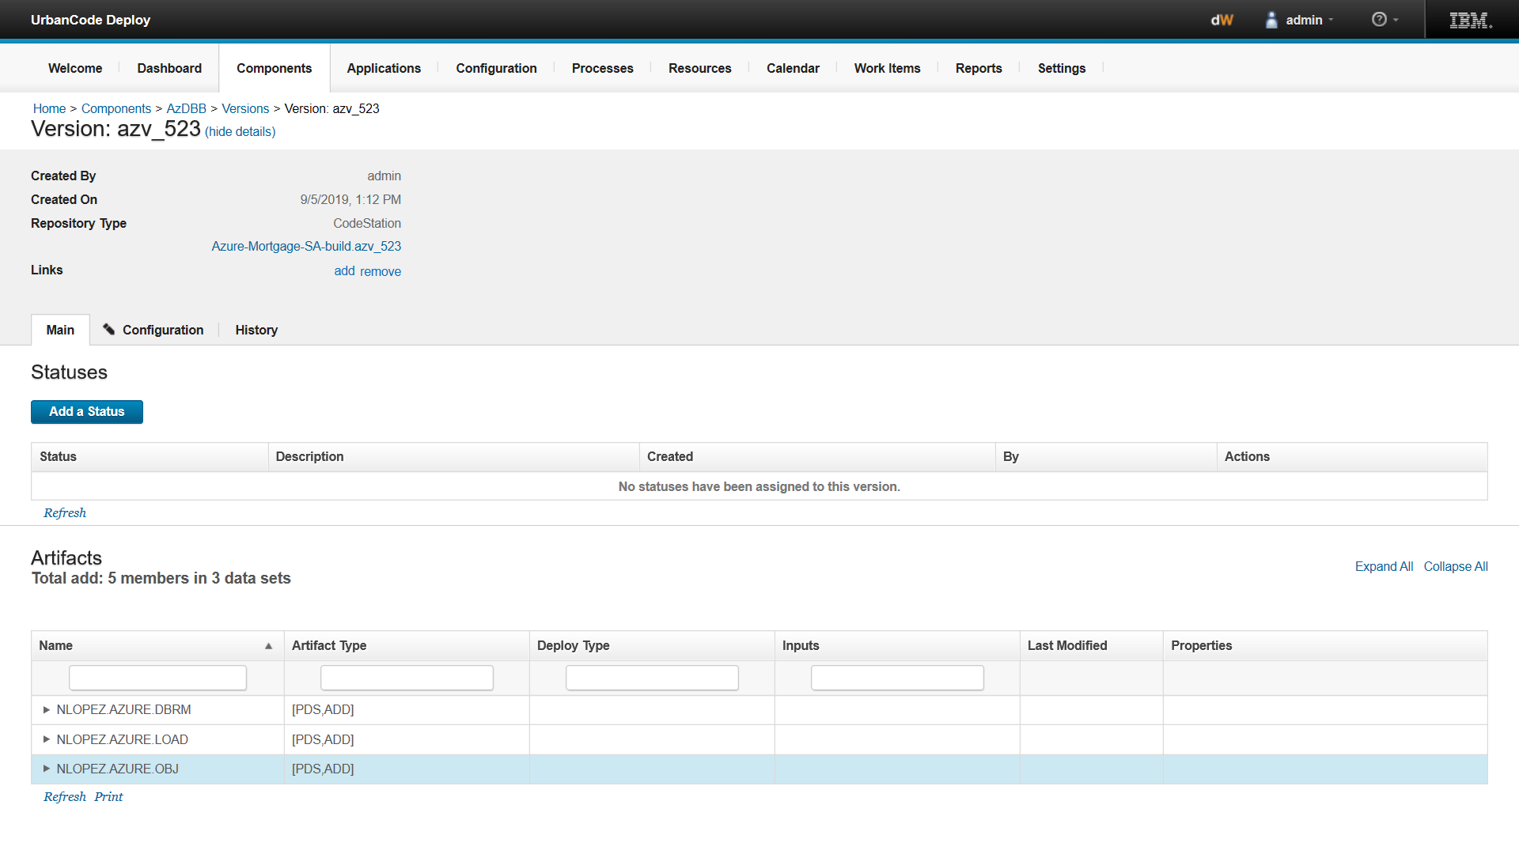
Urban Code Deploy
Artifact Store
Artifact Store
Link to trace back to DBB Build Report for this release

Slide 28
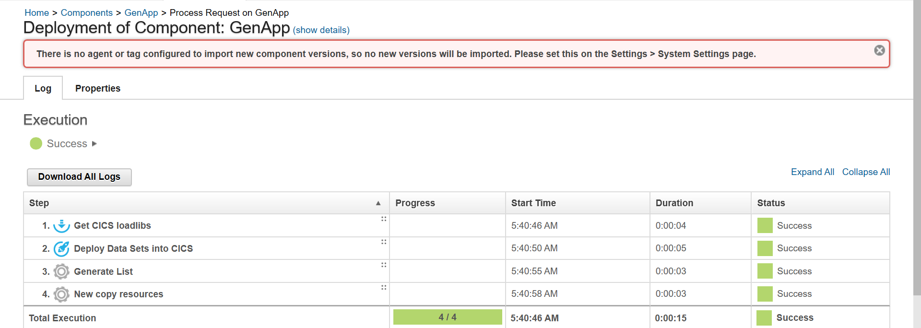
Deployment details
Deployment

Slide 29
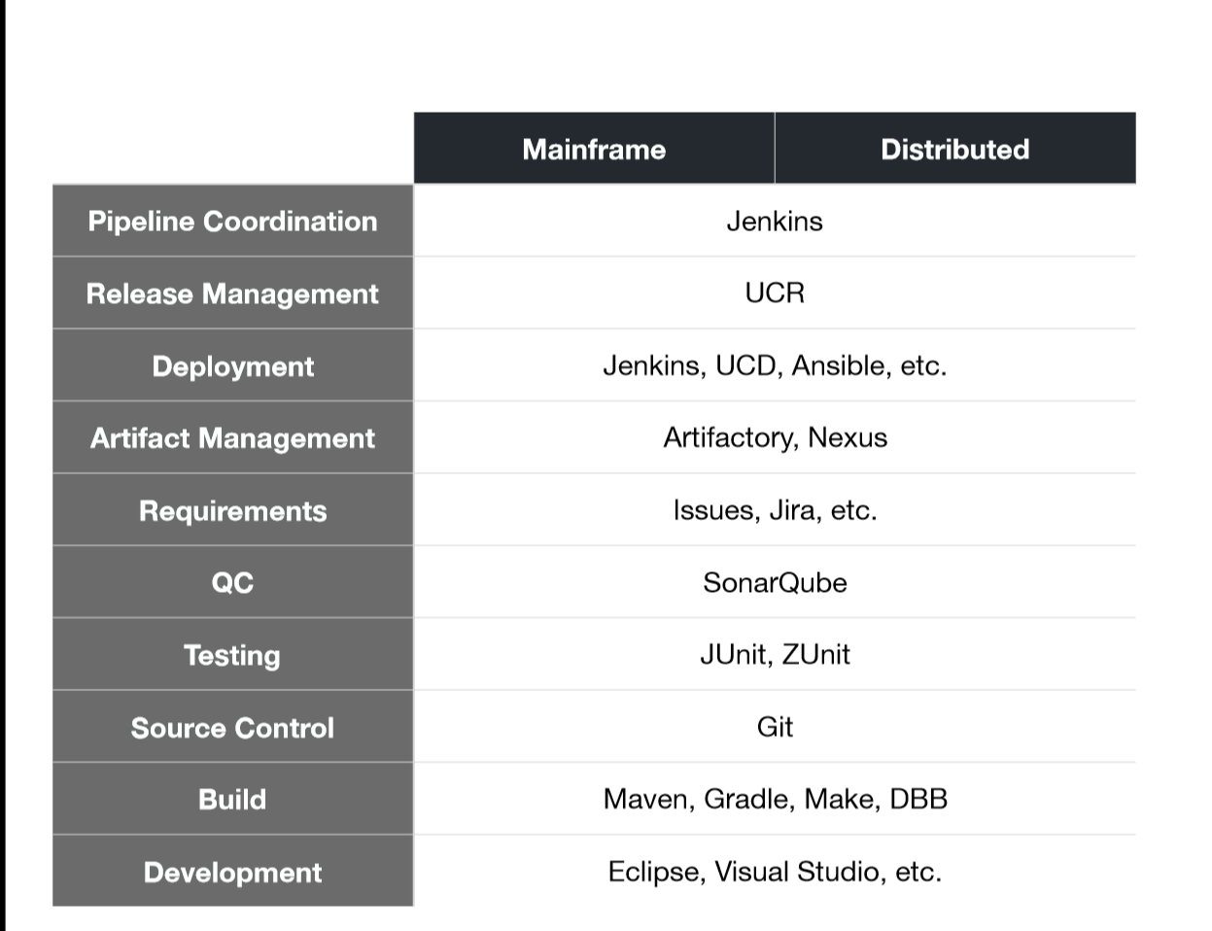
Mainframe | Distributed
Distributed
A common toolchain for all

Slide 30
Big Picture
V1.0.0
V2.0.0
Master
Release
SCM
Git Flow
QA
Dev
Feature
Tools
IDz
Jenkins
DBB/Groovy
Release/Deploy Tool (UCD)
Artifactory
User Build
Unit Test
Team Build
Integration Test
Regression test
Functional test
Pen Test …
Runtime
User
Team
QA
Prod
Dev
QA
PROD

Slide 31
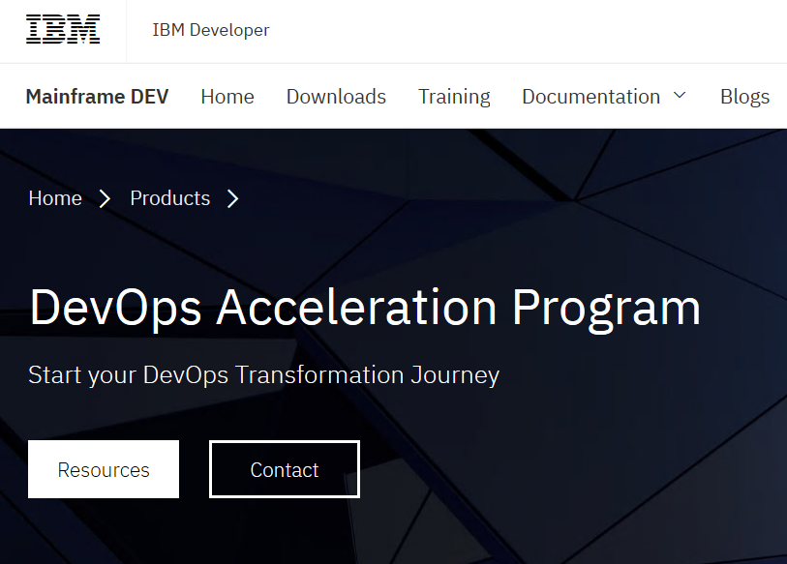
Getting started
https://developer.ibm.com/mainframe/products/devops-acceleration-program/

Slide 32
DevOps transformation journey with IBM’s DevOps Acceleration Program
Train
Discovery & Design
Remote or Onsite discovery and design workshop
Identify current state setup
Determine future state architecture
Deployment
Migration
Any SCM to DBB-Git
Complete assistance from creating your implementation plan, scripts etc.
Know our DevOps strategy and Products
Install and customize products
Train
Discovery & Design
Innovate
Migration
Migrate
Deployment
Lift & shift applications and workloads
SCM Migration – Onsite and remote support
ILT Virtual or Self paced trainings
Build new
cloud native applications
Remote assistance
Remote or onsite workshop

Slide 33
DEMO
Developer Flow - An IDz User Build using Git and DBB
Continuous Integration Build (Team Build) with Jenkins and GitHub
Continuous Delivery with Artificatory
Continuous Deployment with Urban Code

Slide 34
Thank You

